Slide 1
Exploratory Data Analysis

Slide 2
Exploratory Data Analysis
Exploratory data analysis is the data analytics process to understand the data in depth and to learn the different characteristics of data
It helps determine how best to manipulate data sources to get the answers you need, making it easier for data scientists to discover patterns, spot anomalies, test a hypothesis, or check assumptions.

Slide 5
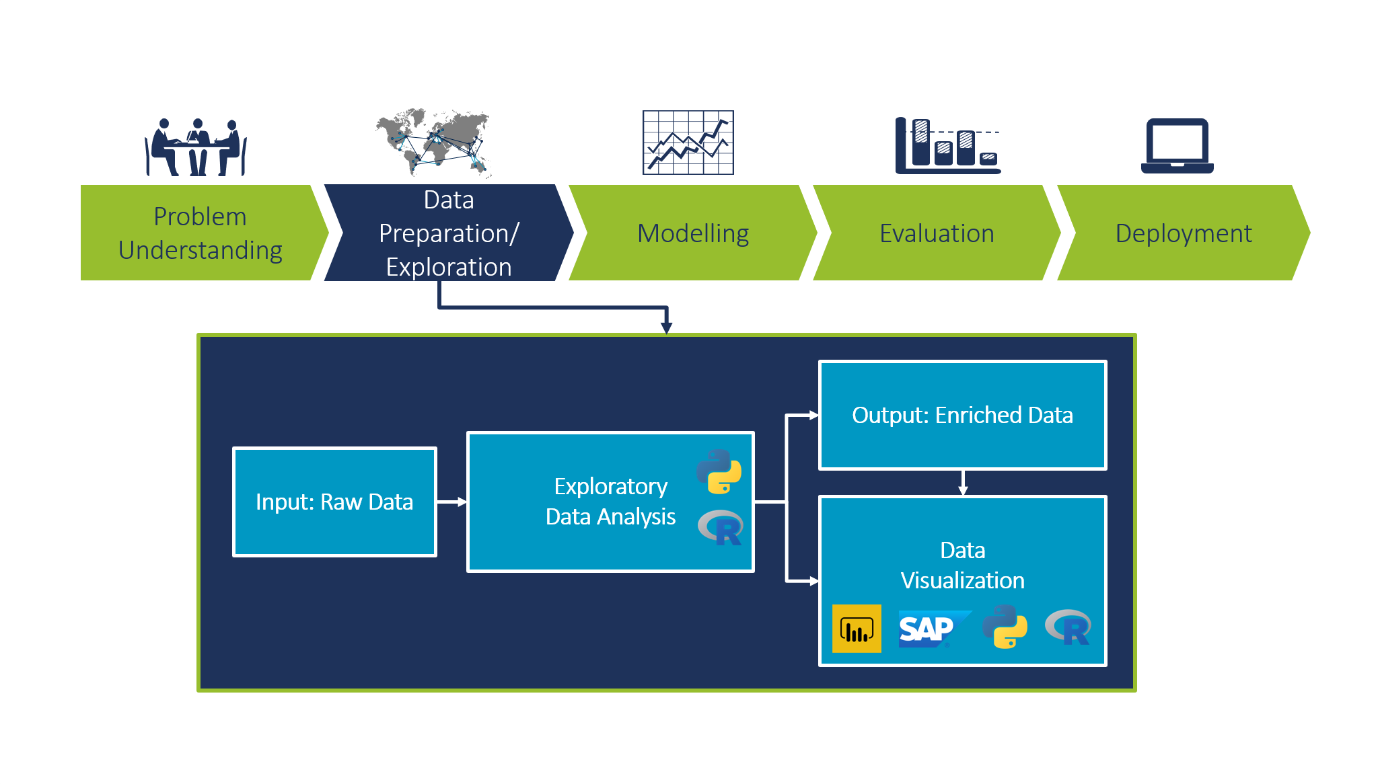

Slide 6
Why Exploratory Data Analysis
The main purpose of EDA is to help look at data before making any assumptions. It can help identify obvious errors, as well as better understand patterns within the data, detect outliers or anomalous events, find interesting relations among the variables.
Data scientists can use exploratory analysis to ensure the results they produce are valid and applicable to any desired business outcomes and goals.

Slide 7
Some Reasons
Remove irregularities and unnecessary values from data
Help us prepare out dataset for analysis
Allows a Machine learning model to better predict on our dataset.
Give us more accurate result.
It also help us in choosing a better machine learning model.

Slide 8
Steps Involve in EDA
Data Collection
Data Cleaning
Univariate Analysis
Bivariate Analysis
Multivariate Analysis

Slide 9
Data Collection

Slide 10
Data Cleaning

Slide 11
Univariate Analysis
While 'uni' means one, variate indicates a variable. Therefore, univariate analysis is a form of analysis that only involves a single variable. In a practical setting, a univariate analysis means the analysis of a single variable (or column) in a dataset (data table).
This type of data consists of only one variable. The analysis of univariate data is thus the simplest form of analysis since the information deals with only one quantity that changes. It does not deal with causes or relationships and the main purpose of the analysis is to describe the data and find patterns that exist within it. The example of a univariate data can be height
The examination of the distribution of case on only one variable at a time. (Example – Weight of college students)

Slide 12
Suppose that the heights of seven students of a class is recorded(figure 1),there is only one variable that is height and it is not dealing with any cause or relationship. The description of patterns found in this type of data can be made by drawing conclusions using central tendency measures (mean, median and mode), dispersion or spread of data (range, minimum, maximum, quartiles, variance and standard deviation) and by using frequency distribution tables, histograms, pie charts, frequency polygon and bar charts.

Slide 13
In univariate analysis, you’re often looking at measures like
Measures of Central Tendency: Mean, median, and mode provide insights into where the center of the data lies.
Measures of Dispersion: Range, variance, and standard deviation help you understand how spread out the data is.
Frequency Distribution: Creating histograms, bar charts, and pie charts allows you to visualize the data’s distribution.

Slide 14
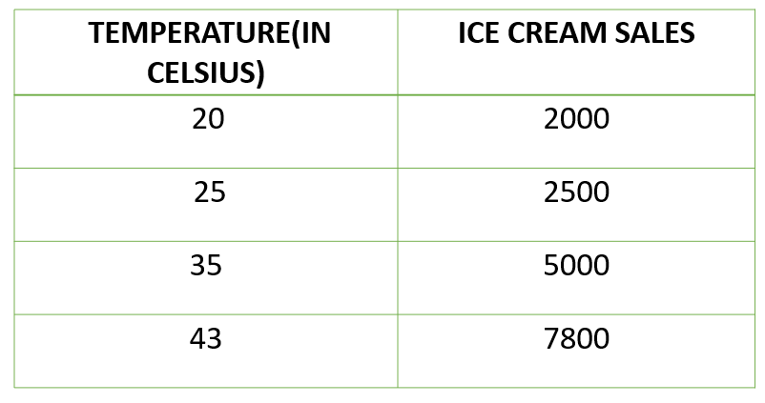
Bivariate
This type of data involves two different variables. The analysis of this type of data deals with causes and relationships and the analysis is done to find out the relationship among the two variables. Example of bivariate data can be temperature and ice cream sales in summer season.

Slide 15
Example
Suppose the temperature and ice cream sales are the two variables of a bivariate data(figure 2). Here, the relationship is visible from the table that temperature and sales are directly proportional to each other and thus related because as the temperature increases, the sales also increase. Thus bivariate data analysis involves comparisons, relationships, causes and explanations. These variables are often plotted on X and Y axis on the graph for better understanding of data and one of these variables is independent while the other is dependent.

Slide 16
Bivariate Analysis
The examination of two variable simultaneously.(Example – The relation between gendar and weight of the college students)
Bivariate analysis is one of the statistical analysis where two variables are observed. One variable here is dependent while the other is independent.
Bivariate analysis is a statistical method examining how two different things are related. The bivariate analysis aims to determine if there is a statistical link between the two variables and, if so, how strong and in which direction that link is.

Slide 17
Some reasons why bivariate analysis is important
Bivariate analysis helps identify trends and patterns: It can reveal hidden data trends and patterns by evaluating the relationship between two variables.
Bivariate analysis helps identify cause and effect relationships: It can assess if two variables are statistically associated, assisting researchers in establishing which variable causes the other.
It helps researchers make predictions: It allows researchers to predict future results by modeling the link between two variables.
It helps inform decision-making: Business, public policy, and healthcare decision-making can benefit from bivariate analysis.

Slide 18
Types of bivariate analysis
Scatterplots - A scatterplot is a graph that shows how two variables are related to each other. It shows the values of one variable on the x-axis and the values of the other variable on the y-axis.
Correlation - Correlation is a statistical measure that shows how strong and in what direction two variables are linked.
A positive correlation means that when one variable goes up, so does the other. A negative correlation shows that when one variable goes up, the other one goes down.
Regression
This kind of analysis gives you access to all terms for various instruments that can be used to identify potential relationships between your data points.

Slide 19
Chi-square test
The chi-square test is a statistical method for identifying disparities in one or more categories between what was expected and what was observed. The test’s primary premise is to assess the actual data values to see what would be expected if the null hypothesis was valid.
Researchers use this statistical test to compare categorical variables within the same sample group. It also helps to validate or offer context for frequency counts.

Slide 20
T-test
A t-test is a statistical test that compares the means of two groups to see if they have a big difference. This analysis is appropriate when comparing the averages of two categories of a categorical variable.

Slide 21
ANOVA (Analysis of Variance)
The ANOVA test determines whether the averages of more than two groups differ from one another statistically. This comparison of averages of a numerical variable for more than two categories of a categorical variable is appropriate.

Slide 22
Example of bivariate analysis
Investigating the connection between education and income
In this case, one of the variables could be the level of education (e.g., high school, college, graduate school), and the other could be income.
A bivariate analysis could be used to determine if there is a significant relationship between these two variables and, if so, how strong and in what direction that relationship is.

Slide 23
Example 2
Investigating the connection between aging and blood pressure
Here, age is one variable and blood pressure is another (systolic and diastolic).
It is possible to conduct an analysis of bivariate analysis to determine if and how strongly these two factors are related by testing for statistical significance.
These are just a few ways this analysis can be used to determine how two variables are related. The type of data and the research question will determine which techniques and statistical tests are used in the analysis.

Slide 24
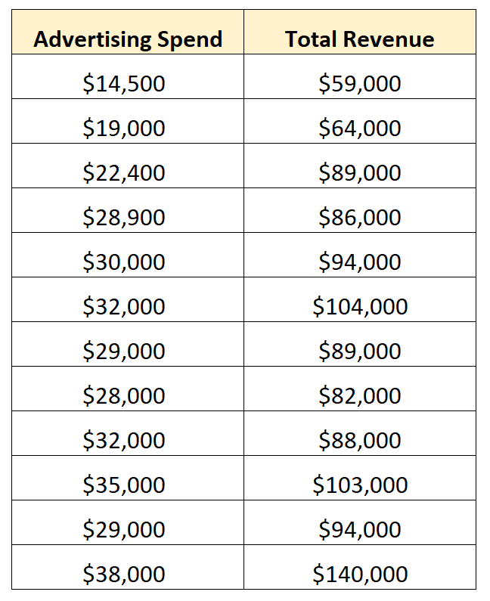
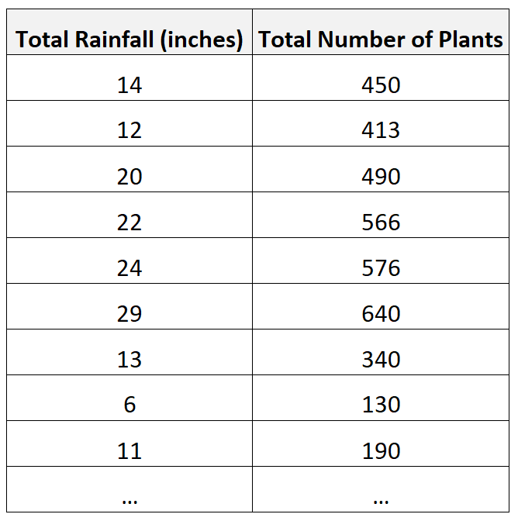

Slide 25
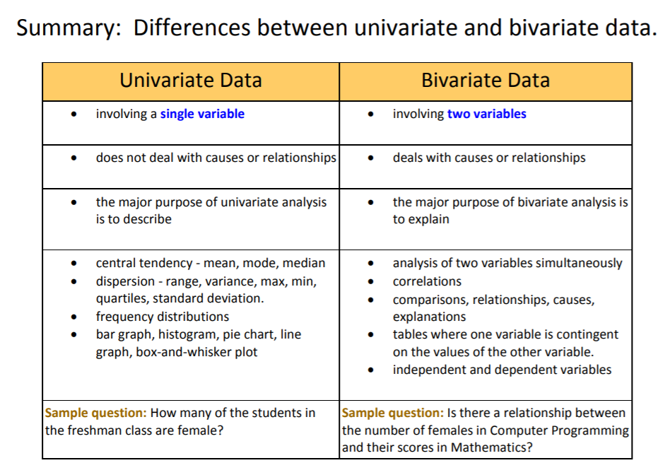

Slide 26
Multivariate analysis
Multivariate analysis (MVA) involves evaluating multiple variables (more than two) to identify any possible association among them. Key takeaways: Multivariate analysis offers a more complete examination of data by looking at all possible independent variables and their relationships to one another.
Multivariate analysis of variance (MANOVA) is used to measure the effect of multiple independent variables on two or more dependent variables.

Slide 27
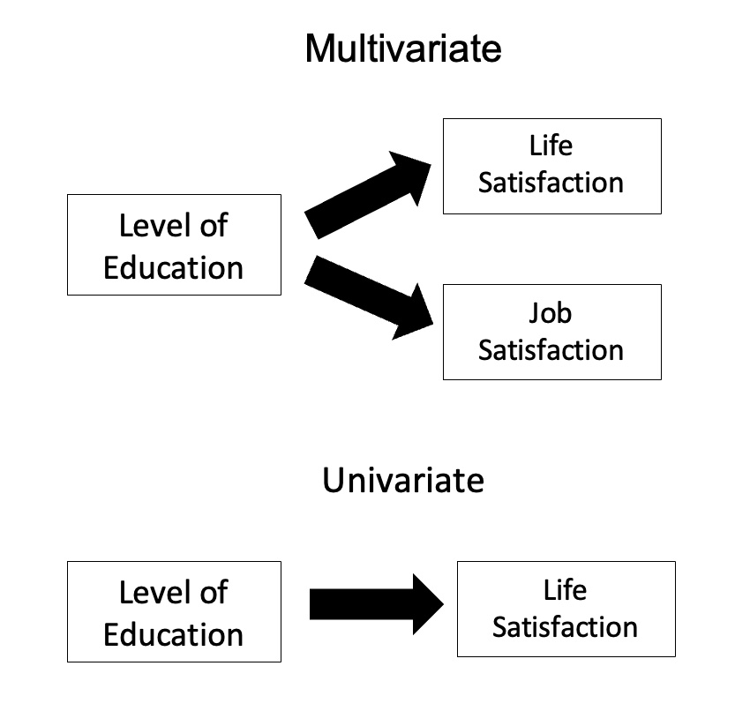
Example
Univariate | Bivariate | Multivariate
It only summarize single variable at a time. | It only summarize two variables | It only summarize more than 2 variables.
It does not deal with causes and relationships. | It does deal with causes and relationships and analysis is done. | It does not deal with causes and relationships and analysis is done.
It does not contain any dependent variable. | It does contain only one dependent variable. | It is similar to bivariate but it contains more than 2 variables.
The main purpose is to describe. | The main purpose is to explain. | The main purpose is to study the relationship among them.
The example of a univariate can be height. | The example of bivariate can be temperature and ice sales in summer vacation. | Example, Suppose an advertiser wants to compare the popularity of four advertisements on a website. Then their click rates could be measured for both men and women and relationships between variable can be examined

Slide 28
Univariate | Bivariate | Multivariate
It only summarize single variable at a time. | It only summarize two variables | It only summarize more than 2 variables.
It does not deal with causes and relationships. | It does deal with causes and relationships and analysis is done. | It does not deal with causes and relationships and analysis is done.
It does not contain any dependent variable. | It does contain only one dependent variable. | It is similar to bivariate but it contains more than 2 variables.
The main purpose is to describe. | The main purpose is to explain. | The main purpose is to study the relationship among them.
The example of a univariate can be height. | The example of bivariate can be temperature and ice sales in summer vacation. | Example, Suppose an advertiser wants to compare the popularity of four advertisements on a website. Then their click rates could be measured for both men and women and relationships between variable can be examined

Slide 29
What is Statistics for Data Analytics?
Statistics is a branch of mathematics dealing with the collection, analysis, interpretation, and presentation of masses of numerical data. It is basically a collection of quantitative data.
Statistics plays a crucial role in data analytics, which is the process of examining, cleaning, transforming, and interpreting data to discover valuable insights, patterns, and trends.

Slide 30
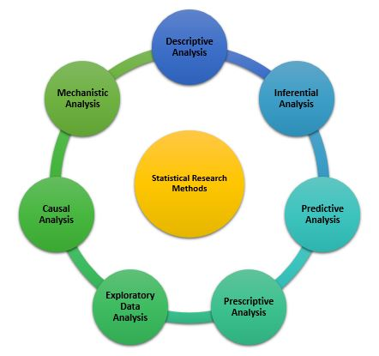

Slide 31
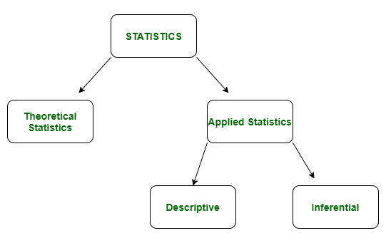
Types of Statistics

Slide 32
Descriptive Statistics
Purpose: Descriptive statistics aim to summarize and describe the main features of a dataset or population. They provide a clear and concise overview of the data, helping researchers and analysts understand its characteristics.
Methods: Descriptive statistics include measures such as mean, median, mode, range, variance, standard deviation, percentiles, and graphical representations like histograms, bar charts, and scatter plots.
Example: Calculating the average income of a group of people, creating a histogram to visualize the distribution of test scores, or reporting the most common blood type in a population are all examples of descriptive statistics.

Slide 33
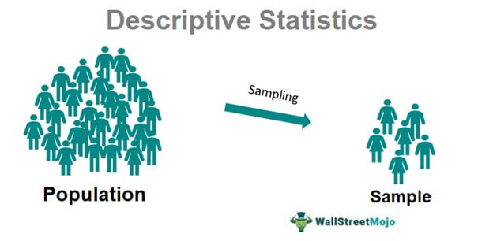
Descriptive Statistics
Descriptive statistics is a term given to the analysis of data that helps to describe, show and summarize data in a meaningful way. It is a simple way to describe our data. Descriptive statistics is very important to present our raw data ineffective/meaningful way using numerical calculations or graphs or tables. This type of statistics is applied to already known data.

Slide 34
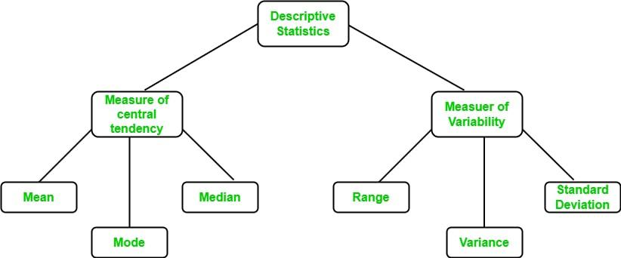

Slide 35
Central Tendency
Central Tendency is a value that determines the central value of the given dataset. The Central Tendency is summarized by 3 terms: Mean, Median, and Mode. It becomes crucial to justify when to use a particular measure for a given data.
Mean is the arithmetic average of a given distribution and is highly affected if data consist of outliers.
Median is the absolute middle value of a given set and separates data into two halves. It is resistant to skewness and does not get affected by outliers.
Mode represents the most frequent value of the dataset. Data can be multimodal if there is more than one value with the same frequency.

Slide 36
Mean
Mean is average of a given set of data. Let us consider below example.
2, 4, 4, 4, 5 ,5, 7, 9
These eight data points have the mean (average) of 5.
2+4+4+4+5+5+7+9/8 = 5

Slide 37
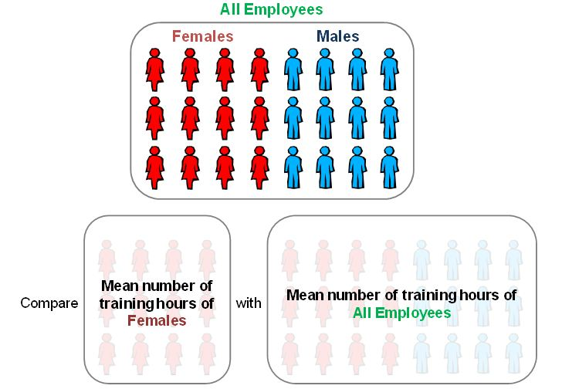
Example- if we would like to know how many hours on average an employee spends at training in a year, we can find the mean training hours of a group of employees

Slide 39
Median

Slide 40
Example
For example, the median of 3, 3, 5, 9, 11 is 5.
If there is an even number of observations, then there is no single middle value; the median is then usually defined to be the mean of the two middle values:
So the median of 3, 5, 7, 9 is (5+7)/2 = 6

Slide 41
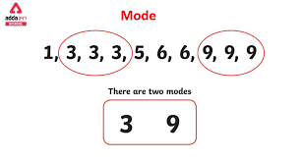
Mode
The mode in statistics refers to a number in a set of numbers that appears the most often.
For example, if a set of numbers contained the following digits, 1, 1, 3, 5, 6, 6, 7, 7, 7, 8, the mode would be 7, as it appears the most out of all the numbers in the set.

Slide 42
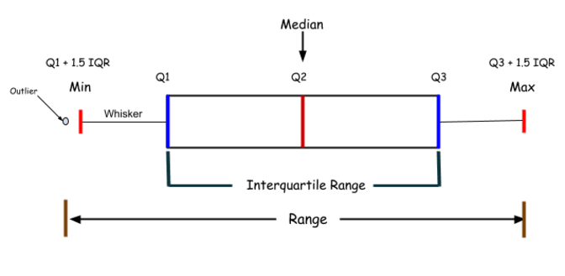
Cont.
When using Statistics for Data Analytics, Mean is preferred when data is symmetrically distributed. However, when data possess skewed characteristics or ordinal type, the Median should be the optimal choice, and if the data type is categorical, the Mode is the best choice.

Slide 43
Variability
In Statistics, the dispersion of data from each other is referred to as variability. It gives an extent to which data can be stretched or squeezed. It can be better understood if we do a univariate analysis of features. A few key terms to be aware of when using Statistics for Data Analytics are –

Slide 44
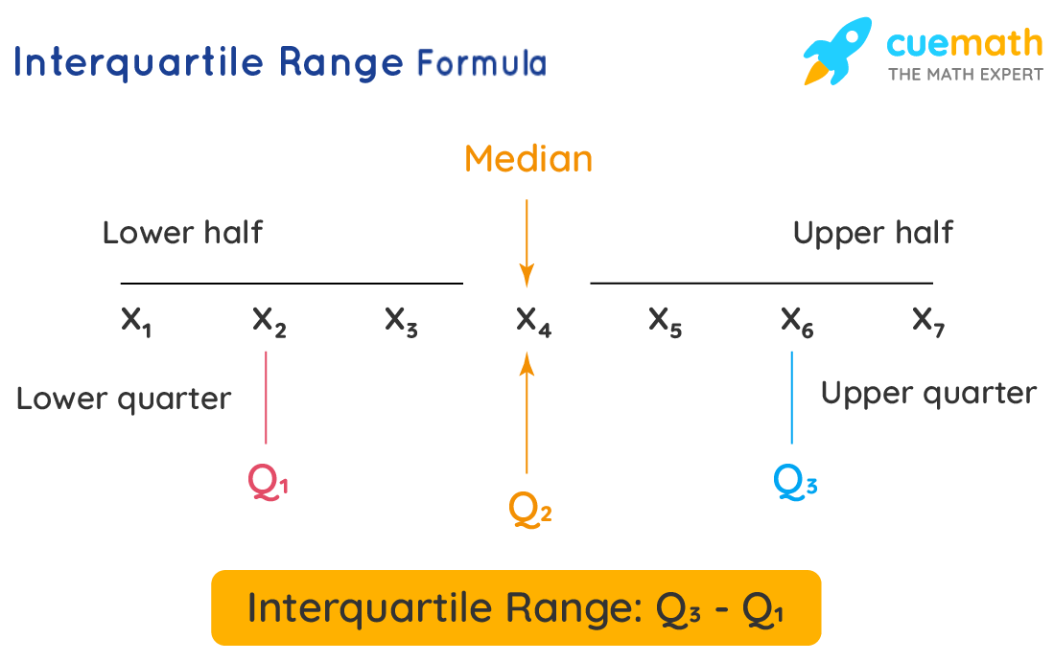
Interquartile Range [IQR]:
The difference between the largest and smallest value is known as Range. If the data is partitioned into four parts, it is termed a Quartile, and the difference between the third and first Quartile is known as IQR. A box plot is used in such cases to determine Spread, Outliers, and IQR.

Slide 45
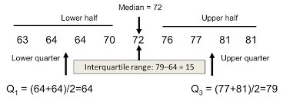
Example
In order to calculate it, you need to first arrange your data points in order from the lowest to the greatest, then identify your 1st and 3rd quartile positions by using the IQR formula (N+1)/4 and 3 × (N+1)/4 respectively, where N represents the number of points in the data set.

Slide 46
Standard Deviation
A value that shows the amount of variation in population data is termed Population Standard Deviation. In a given distribution, the Standard Deviation is used to find how far one value lies from the other. In the actual case, the sample population is calculated where n is the size of the sample and n-1 is the considered sample size

Slide 47
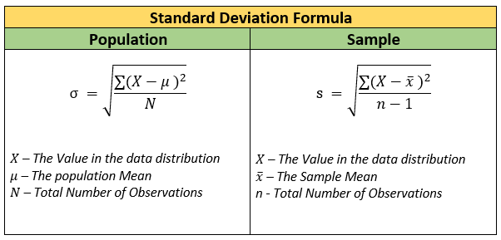
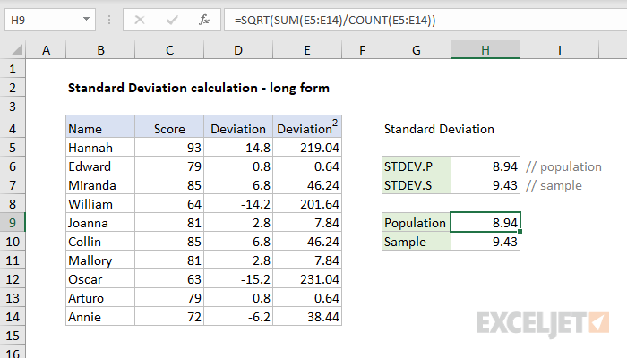

Slide 48
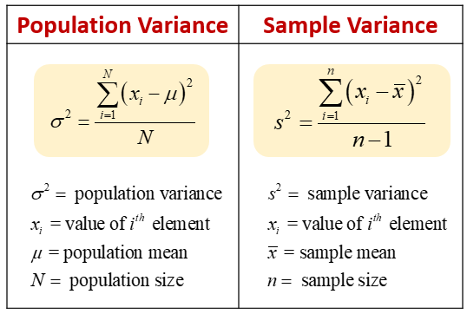
Variance
An average squared deviation obtained on population is termed the Variance. In a given distribution, the Variance value tells us the degree of spread of data. Higher Variance indicates that data points are located away from the Mean.

Slide 49
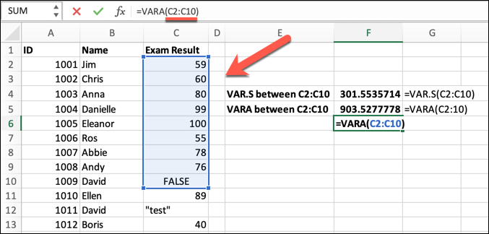
Example-

Slide 50
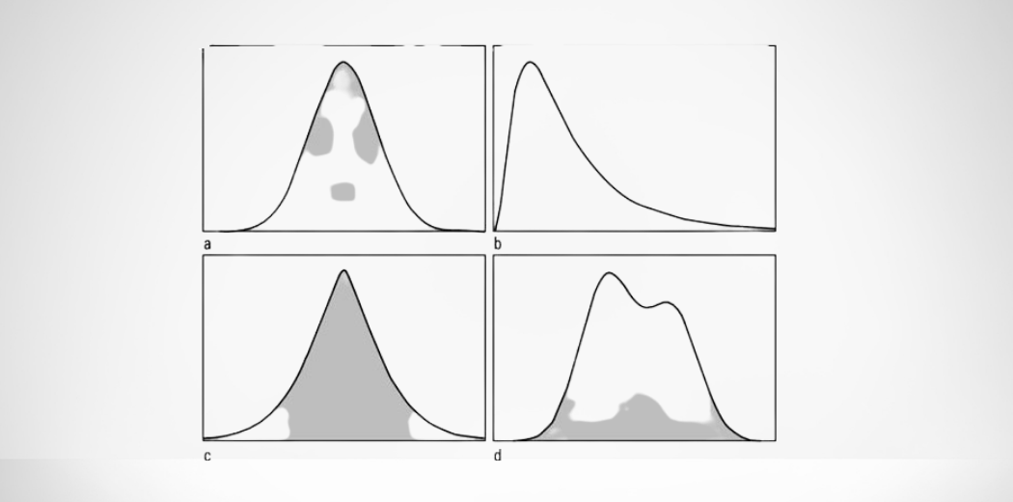
Descriptive Statistics Based on the Shape of the Data
The shape of the data is important because deciding the probability of data is based on its shape. The shape describes the type of the graph.

Slide 51
The shape of the data can be measured by three methodologies
Symmetric
Skewness
Kurtosis

Slide 52
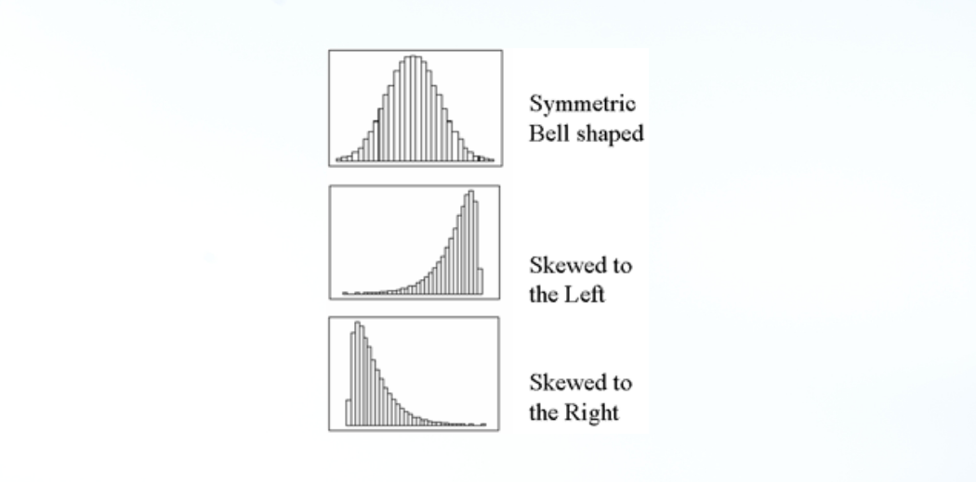
1. Symmetric
In the symmetric shape of the graph, the data is distributed the same on both sides. In symmetric data, the mean and median are located close together. The curve formed by this symmetric graph is called a normal curve.

Slide 53
2. Skewness
Skewness is the measure of the asymmetry of the distribution of data. The data is not symmetrical (i.e.) it is skewed towards one side. Skewness is classified into two types: positive skew and negative skew.
Positively skewed: In a Positively skewed distribution, the data values are clustered around the left side of the distribution, and the right side is longer. The mean and median will be greater than the mode in the positive skew.
Negatively skewed: In a Negatively skewed distribution, the data values are clustered around the right side of the distribution, and the left side is longer. The mean and median will be less than the mode.

Slide 54
Cont..

Slide 55
3. Kurtosis
Kurtosis is the measure of describing the distribution of data. This data is distributed in three different ways: platykurtic, mesokurtic, and leptokurtic.

Slide 56
Platykurtic
The platykurtic shows a distribution with flat tails. Here, the data is distributed fairly. The flat tails indicated the small outliers in the distribution.

Slide 57
Mesokurtic
In Mesokurtic, the data is widely distributed. It is normally distributed, and it also matches normal distribution.

Slide 58
Leptokurtic
In leptokurtic, the data is very closely distributed. The height of the peak is greater than the width of the peak.

Slide 59
Comparative Statistics
Purpose: Comparative statistics involve comparing different datasets or subsets of data to identify patterns, relationships, similarities, or differences between them. The goal is to draw comparisons and make informed decisions.
Methods: Comparative statistics use various statistical techniques such as t-tests, chi-square tests, ANOVA (analysis of variance), and regression analysis to compare groups or variables.
Example: Comparing the average salary of employees in two different departments of a company to determine if there's a significant difference or comparing the crime rates in two cities to assess which one has a higher crime rate are examples of comparative statistics.

Slide 60
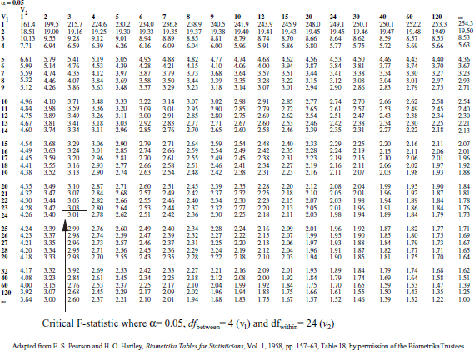

Slide 62
Example
The relationship between variables can be complex; however, a number of characteristics of the relationship can be measured:-
Direction: In comparing two variables, a positive relationship results when higher values in the first variable coincide with higher values in the second variable. In addition, lower values in the first variable coincide with lower values in the second variable. Negative relationships result when higher values in the first variable coincide with lower values in the second variable as well as lower values in the first variable coincide with higher values in the second variable. There are also situations where the relationship between the variables is more complex, having a combination.

Slide 63
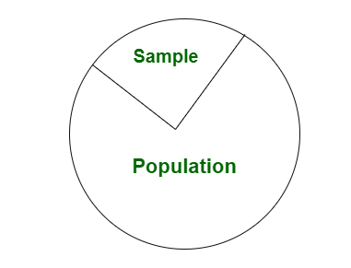
Inferential Statistics
Purpose: Inferential statistics involve drawing conclusions or making predictions about a larger population based on a sample of data. It allows researchers to generalize their findings beyond the sample to the entire population.
Methods: Inferential statistics use techniques like hypothesis testing, confidence intervals, and regression analysis to make inferences or predictions about a population based on sample data.
Example: Conducting a survey of a random sample of voters to estimate the likely election outcome for an entire country, or using a sample of product defects to infer the quality of an entire production batch are examples of inferential statistics.

Slide 64
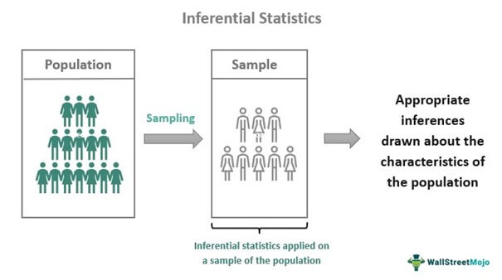

Slide 65
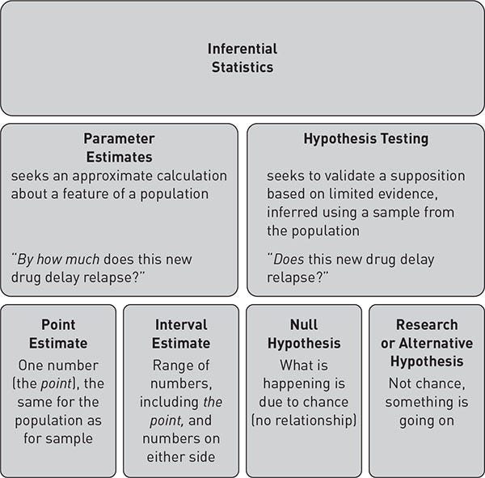

Slide 68
S.No. | Descriptive Statistics | Inferential Statistics
1. | It gives information about raw data which describes the data in some manner. | It makes inferences about the population using data drawn from the population.
2. | It helps in organizing, analyzing, and to present data in a meaningful manner. | It allows us to compare data and make hypotheses and predictions.
3. | It is used to describe a situation. | It is used to explain the chance of occurrence of an event.
4. | It explains already known data and is limited to a sample or population having a small size. | It attempts to reach the conclusion about the population.
5. | It can be achieved with the help of charts, graphs, tables, etc. | It can be achieved by probability.

Slide 69
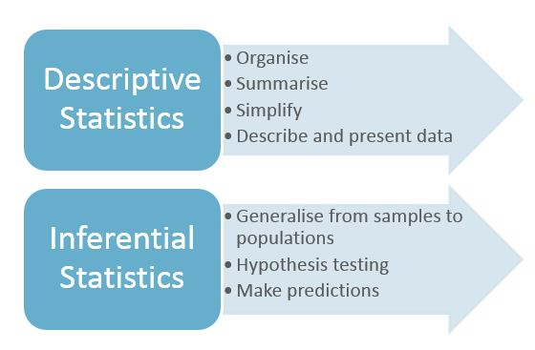

Slide 70
Hypothesis Testing
Hypothesis testing is a form of statistical inference that uses data from a sample to draw conclusions about a population parameter or a population probability.
Hypothesis testing is a statistical method that is used in making a statistical decision using experimental data.

Slide 71
Need for Hypothesis Testing
Hypothesis testing is an important procedure in statistics. Hypothesis testing evaluates two mutually exclusive population statements to determine which statement is most supported by sample data. When we say that the findings are statistically significant, it is thanks to hypothesis testing.
Mutual Exclusive
Non-Mutual Exclusive
A
B
A
B

Slide 72
Example
You say an average student in the class is 30 or a boy is taller than a girl. All of these is an assumption that we are assuming, and we need some statistical way to prove these. We need some mathematical conclusion whatever we are assuming is true.

Slide 73
Parameters of Hypothesis Testing
Hypothesis Testing
Null Hypothesis (H0)
Alternative Hypothesis(H1)
Level of Significance
P Value

Slide 74
Null Hypothesis
In statistics, the null hypothesis is a general given statement or default position that there is no relationship between two measured cases or no relationship among groups. In other words, it is a basic assumption or made based on the problem knowledge.
Example: A company production is = 50 units/per day etc.

Slide 75
Alternative Hypothesis(H1)
The alternative hypothesis is the hypothesis used in hypothesis testing that is contrary to the null hypothesis.
Example: A company’s production is not equal to 50 units/per day etc.

Slide 76
Level of significance
It refers to the degree of significance in which we accept or reject the null hypothesis. 100% accuracy is not possible for accepting a hypothesis, so we, therefore, select a level of significance that is usually 5%. This is normally denoted with alpha and generally, it is 0.05 or 5%. Which means your output should be 95% confident to give a similar kind of result in each sample.

Slide 77
P-value
The P value, or calculated probability, is the probability of finding the observed/extreme results when the null hypothesis(H0) of a study-given problem is true. If your P-value is less than the chosen significance level then you reject the null hypothesis i.e. accept that your sample claims to support the alternative hypothesis.

Slide 78
Steps in Hypothesis Testing
Step 1– We first identify the problem about which we want to make an assumption keeping in mind that our assumption should be contradictory to one another
Step 2 – We consider statical assumption such that the data is normal or not, statical independence between the data.
Step 3 – We decide our test data on which we will check our hypothesis
Step 4 – The data for the tests are evaluated in this step we look for various scores in this step like z-score and mean values.
Step 5 – In this stage, we decide where we should accept the null hypothesis or reject the null hypothesis

Slide 79
Example
Given a coin and it is not known whether that is fair or tricky so let’s decide the null and alternate hypothesis.
Null Hypothesis(H0): a coin is a fair coin.
Alternative Hypothesis(H1): a coin is a tricky coin.
Alpha=5
Toss a coin 1st time and assume that the result is head- P-value = 50 (as head and tail have equal probability)
Toss a coin 2nd time and assume that result again is head, now p-value = 50/2=25

Slide 80
Cont..
and similarly, we Toss 6 consecutive times and got the result as all heads, now P-value = 1.5 But we set our significance level as an error rate we allow and here we see we are beyond that level i.e. our null- hypothesis does not hold good so we need to reject and propose that this coin is a tricky coin which is actually because it gives us 6 consecutive heads.

Slide 81
Formula For Hypothesis Testing
To validate our hypothesis about a population parameter we use statistical functions. we use the z-score, p-value, and, level of significance(alpha) to make evidence for our hypothesis.

Slide 82
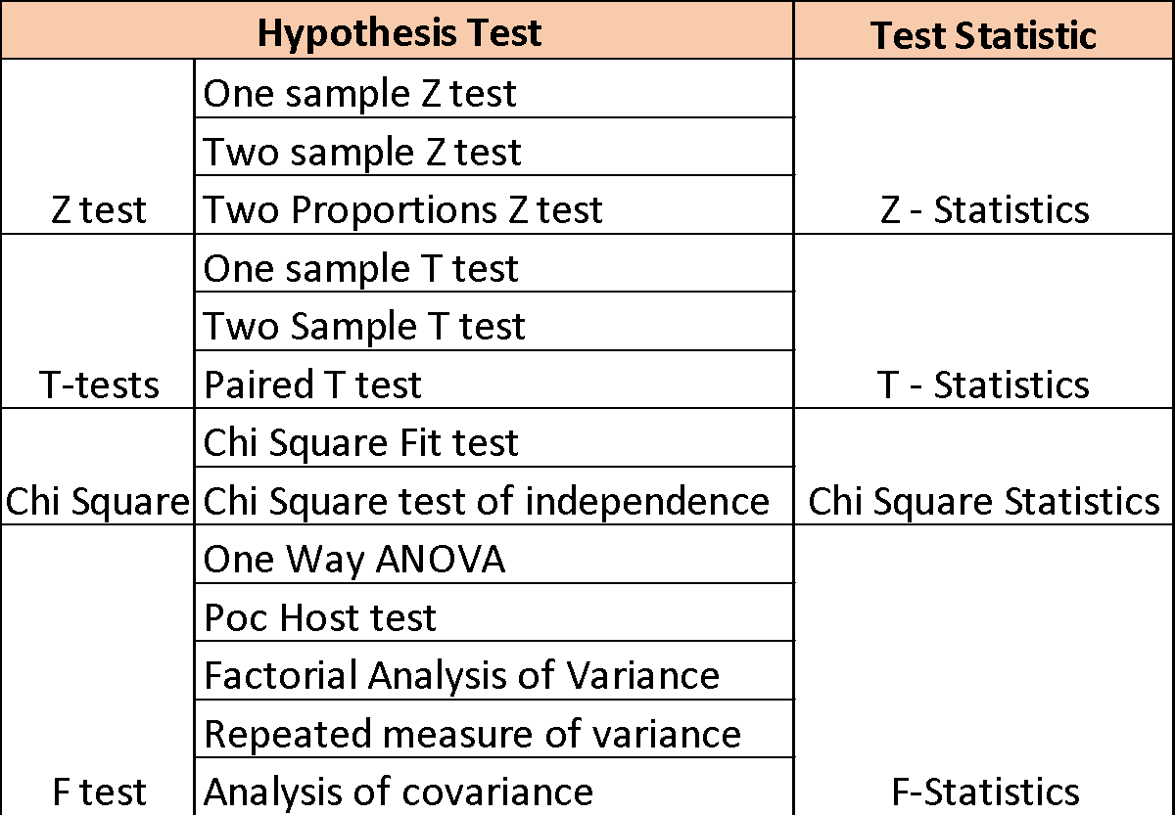

Slide 84
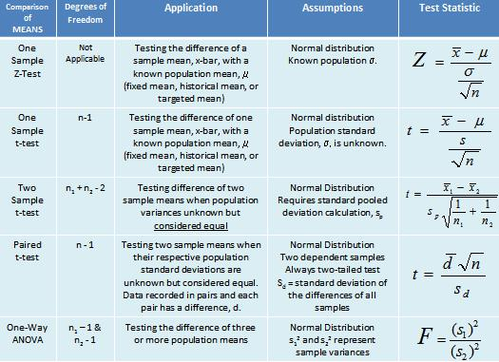

Slide 85
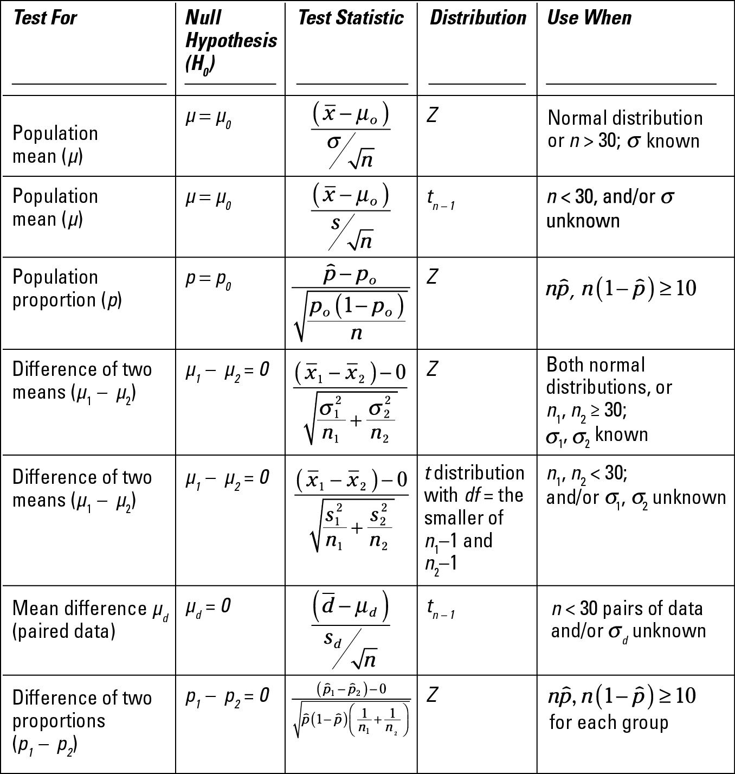

Slide 86
Hypothesis Test

Slide 87
Python Implementation
We will use the scipy python library to compute the p-value and z-score for our sample dataset. Scipy is a mathematical library in Python that is mostly used for mathematical equations and computations. In this code, we will create a function hypothesis_test in which we will pass arguments like pop_mean(population parameter upon which we are checking our hypothesis), sample dataset, level of confidence(alpha value), and type of testing (whether it’s a one-tailed test or two-tailed test).

Slide 88
Cont.
The information we are using in this Hypothesis test is
Level of confidence – 0.5
Null hypothesis – population mean = 5.0
Alternative hypothesis – population mean != 5.0

Slide 89
Evaluate Hypothesis Function on Sample Dataset
To evaluate our hypothesis test function we will create a sample dataset of 20 points having 4.5 as the mean and 2 as the standard deviation. Here, We will consider that our population has a mean equals to 5 .

Slide 90
np.random.seed(0)
#enables you to provide a seed (i.e., the starting input) for NumPy’s #pseudo-random number generator.
sample = np.random.normal(loc=4.5, scale=2, size=20)
#numpy.random.normal(loc = 0.0, scale = 1.0, size = None) :
#creates an array of specified shape and fills it with random values which is actually a part of Normal(Gaussian)Distribution
#loc : [float or array_like]Mean of the distribution.
#scale : [float or array_like]Standard Derivation of the distribution.
#size : [int or int tuples].
#Output shape given as (m, n, k) then m*n*k samples are drawn.
# If size is None(by default), then a single value is returned
pop_mean = 5.0
# Test the null hypothesis that
# the population mean is equal to 5.0
z, p_value, result = hypothesis_test(sample, pop_mean)
print(f"Test statistic: {z:.4f}")
print(f"P-value: {p_value:.4f}")
print(f"Result: {result} null hypothesis at alpha=0.05")

Slide 91
import numpy as np
from scipy.stats import norm
def hypothesis_test(sample, pop_mean,
alpha=0.05, two_tailed=True):
# len sample dataset
n = len(sample)
# mean and stard-deviation of dataset
sample_mean = np.mean(sample)
sample_std = np.std(sample, ddof=1)
#The ddof (Delta Degrees of Freedom) parameter in np. std()
#allows adjusting the divisor used in the calculation of standard deviation. The default value is 0, which corresponds to dividing by N, the number of elements.
# Calculate the test statistic

Slide 92
Cont..
# Calculate the test statistic
z = (sample_mean - pop_mean) / (sample_std / np.sqrt(n))
# Calculate the p-value based on the test type
if two_tailed:
p_value = 2 * (1 - norm.cdf(abs(z)))
#Convert Z-score (Z-value, standard score) to p-value for normal distribution with cumulative distribution function in Python
#The Cumulative Distribution Function or CDF is: The probability of all outcomes less than or equal to a given value x
else:
if z < 0:
p_value = norm.cdf(z)
else:
p_value = 1 - norm.cdf(z)

Slide 93
Cont..
# Determine whether to reject or fail to
# reject the null hypothesis
if p_value < alpha:
result = "reject"
else:
result = "fail to reject"
return z, p_value, result

Slide 94
Cont..
In the above example, we can see that we are getting a p-value of 0.101 from the dataset which is less than our level of confidence(alpha value) which is 0.5 hence in this case we will reject our null hypothesis the population mean is 5.0
What if we get a p-value greater than our test statistics but we still reject our null hypothesis in this case we will be making an error. Based on the error we make we define error in two types.

Slide 95
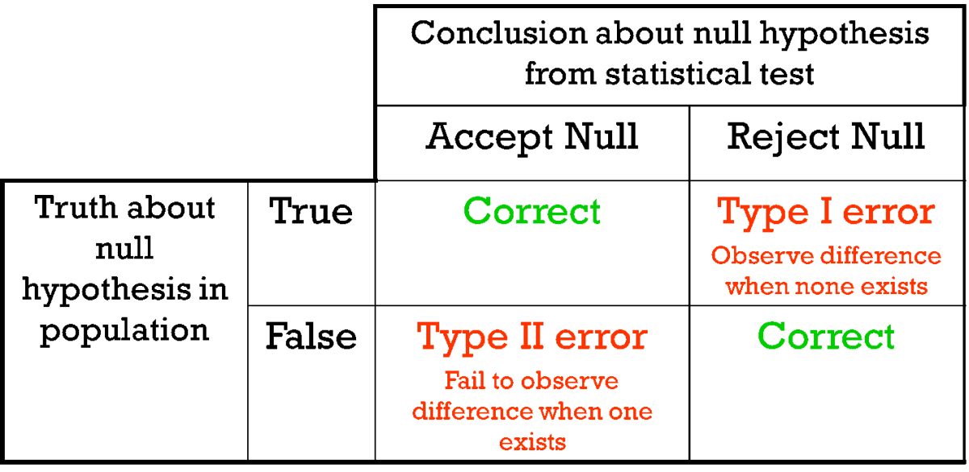
Error in Hypothesis Testing
Type I error: When we reject the null hypothesis, although that hypothesis was true. Type I error is denoted by alpha.
Type II errors: When we accept the null hypothesis but it is false. Type II errors are denoted by beta.

Slide 96
What does p-value of 0.05 mean?
Is a 0.05 P-value Significant? A p-value less than 0.05 is typically considered to be statistically significant, in which case the null hypothesis should be rejected. A p-value greater than 0.05 means that deviation from the null hypothesis is not statistically significant, and the null hypothesis is not rejected.

Slide 97
Association Rule Mining
Association rule mining finds interesting associations and relationships among large sets of data items. This rule shows how frequently a itemset occurs in a transaction. A typical example is a Market Based Analysis.
Market Based Analysis is one of the key techniques used by large relations to show associations between items.It allows retailers to identify relationships between the items that people buy together frequently.
Given a set of transactions, we can find rules that will predict the occurrence of an item based on the occurrences of other items in the transaction.

Slide 98
Cont..
Given a set of transactions, we can find rules that will predict the occurrence of an item based on the occurrences of other items in the transaction.
TID | Items
1 | Bread, Milk
2 | Bread, Diaper, Beer, Eggs
3 | Milk, Diaper, Beer, Coke
4 | Bread, Milk, Diaper, Beer
5 | Bread, Milk, Diaper, Coke

Slide 99
Cont…
Before we start defining the rule, let us first see the basic definitions.
Support Count(\sigma) – Frequency of occurrence of a itemset.
Here \sigma({Milk, Bread, Diaper})=2
Frequent Itemset – An itemset whose support is greater than or equal to minsup threshold.
Association Rule – An implication expression of the form X -> Y, where X and Y are any 2 itemsets.
Example: {Milk, Diaper}->{Beer}

Slide 100
Rule Evaluation Metrics
Support(s) –
The number of transactions that include items in the {X} and {Y} parts of the rule as a percentage of the total number of transaction.It is a measure of how frequently the collection of items occur together as a percentage of all transactions.
Support = \sigma(X+Y) / total –
It is interpreted as fraction of transactions that contain both X and Y.
Confidence(c) –
It is the ratio of the no of transactions that includes all items in {B} as well as the no of transactions that includes all items in {A} to the no of transactions that includes all items in {A}.

Slide 101
Cont…
It measures how often each item in Y appears in transactions that contains items in X also.
Lift(l) – The lift of the rule X=>Y is the confidence of the rule divided by the expected confidence, assuming that the itemsets X and Y are independent of each other.The expected confidence is the confidence divided by the frequency of {Y}.
Conf(X=>Y) = Supp(X U Y) /Supp(X) –

Slide 102
Cont…
Lift value near 1 indicates X and Y almost often appear together as expected, greater than 1 means they appear together more than expected and less than 1 means they appear less than expected. Greater lift values indicate stronger association.
Lift(X=>Y) = Conf(X=>Y) /Supp(Y) –

Slide 103
Example –
From the above table, {Milk, Diaper}=>{Beer}
s= \sigma({Milk, Diaper, Beer}) \div |T|
= 2/5
= 0.4
c= \sigma(Milk, Diaper, Beer) \div \sigma(Milk, Diaper)
= 2/3
= 0.67
l= Supp({Milk, Diaper, Beer}) \div Supp({Milk, Diaper})*Supp({Beer})
= 0.4/(0.6*0.6)
= 1.11

Slide 104
Cont..
The Association rule is very useful in analyzing datasets. The data is collected using bar-code scanners in supermarkets. Such databases consists of a large number of transaction records which list all items bought by a customer on a single purchase. So the manager could know if certain groups of items are consistently purchased together and use this data for adjusting store layouts, cross-selling, promotions based on statistics.

Slide 107
Association Rule Mining Algorithms

Slide 108
Apriori algorithm
The Apriori algorithm is one of the most widely used algorithms for association rule mining. It works by first identifying the frequent itemsets in the dataset (itemsets that appear in a certain number of transactions). It then uses these frequent itemsets to generate association rules, which are statements of the form "if item A is purchased, then item B is also likely to be purchased." The Apriori algorithm uses a bottom-up approach, starting with individual items and gradually building up to more complex itemsets.

Slide 109
FP-Growth algorithm
The FP-Growth (Frequent Pattern Growth) algorithm is another popular algorithm for association rule mining. It works by constructing a tree-like structure called a FP-tree, which encodes the frequent itemsets in the dataset. The FP-tree is then used to generate association rules in a similar manner to the Apriori algorithm. The FP-Growth algorithm is generally faster than the Apriori algorithm, especially for large datasets.

Slide 110
ECLAT algorithm
The ECLAT (Equivalence Class Clustering and bottom-up Lattice Traversal) algorithm is a variation of the Apriori algorithm that uses a top-down approach rather than a bottom-up approach. It works by dividing the items into equivalence classes based on their support (the number of transactions in which they appear). The association rules are then generated by combining these equivalence classes in a lattice-like structure. It is a more efficient and scalable version of the Apriori algorithm.

